Slide 1
Emotion pipeline
GROUP 4

Slide 2
Contents
Business
Data
Models
Full pipeline
Ethical considerations
Future directions

Slide 3

Business
Our understanding of the problem – LLM's
The goal – cheaper and revolutionary
Our project – New pipeline integrations

Slide 4
The data
Emotion analysis
Go emotions (58k samples)
Machine translation
Open subtitles NL - EN
200k sentences
Problems
Additional data added
Test data

Slide 5
Speech to text
Assembly AI
Whisper
Results
Problems
TradeOff

Slide 6
Features
POS-Tagging
TF-IDF

Slide 7
Features
Embeddings
Speaker Tagging

Slide 8
Models
Name | Evaluation | Pro's | Con's
Logistic Regression | Weighted F1 0.46 Minority classes rarely classified | Fast & Easy | Doesn’t perform well on non-linear data
Naïve Bayes | Weighted F1 0.49 Completely failed to classify minority classes | Works well on small datasets | Doesn't capture relationship between words
LSTM | Weighted F1 0.55 Completely failed to classify minority classes | Word order Long term dependencies | Prone to overfitting Computationally heavy to train

Slide 9
Transformer
Roberta-base-go-emotions
Test Weighted F1 Score: 0.77
Not able to effectively capture minority classes
Pros:
Contextual understanding
Cons:
Computationally heavy to train
Low explainability

Slide 10
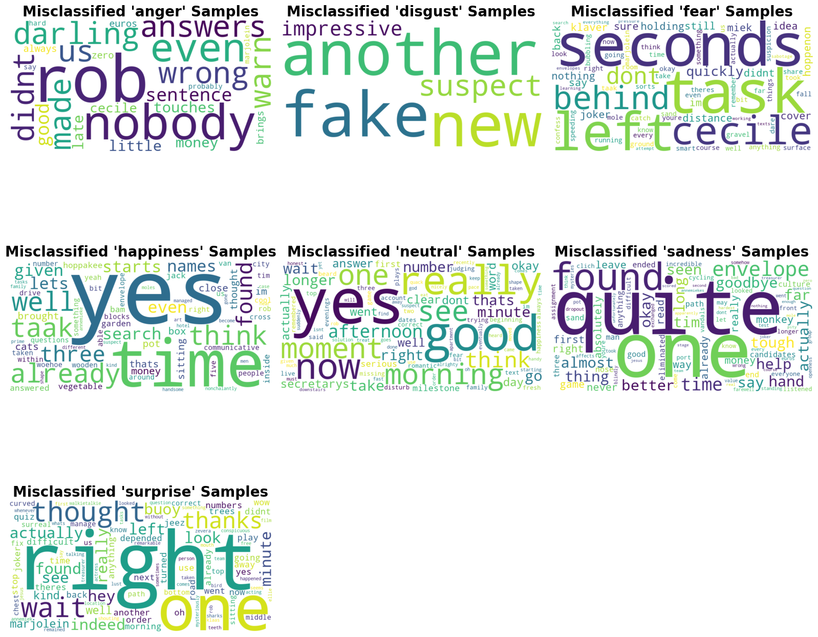
Transformer -Results
Translation errors
Short sentences contribute a lot of noise to the neutral
Most confused classes Happiness and neutral

Slide 11
Machine Translation
Data prerocessing and architecture (enc – dec)
Training
Results with checking and BLEU
Future direction in the pipeline

Slide 12
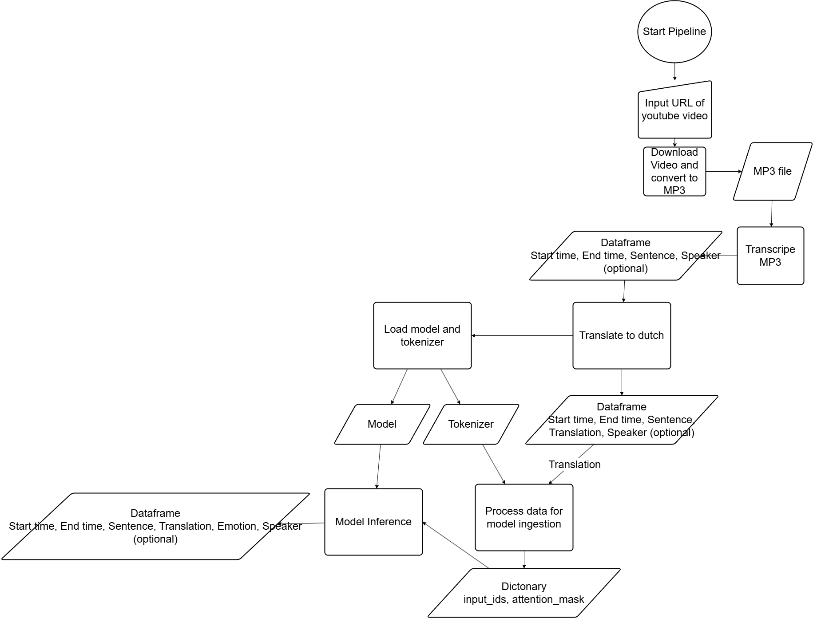
Pipeline Design

Slide 13
Pipeline Limitations
Transcription accuracy VS Computional time
Low recall and accuracy for minority classes
Video download with only works on youtube
Feature extraction not integrated

Slide 14
Ethical considerations
Data privacy
Emotional profiling
Representation

Slide 15
Future directions
Data limitations
Full integration
Model optimization

